Slide 1

File Handling & Exceptions
Today’s Agenda
File Handling Basics
Reading & Writing Files
Introduction to Errors & Exceptions
Using Try-Except for Error Handling
Hands-On Practice
Kahoot(Quiz)

Slide 2
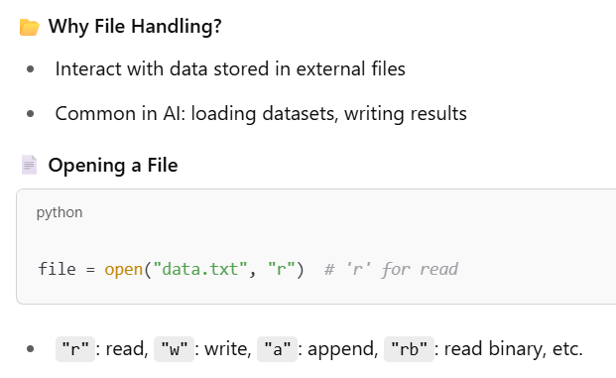
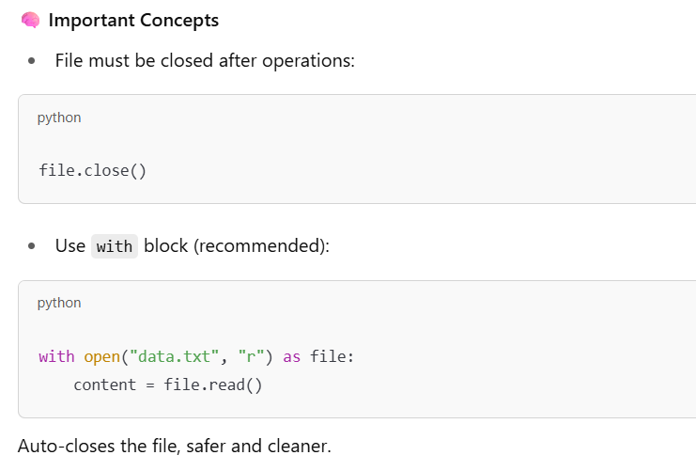
File Handling Basics

Slide 3
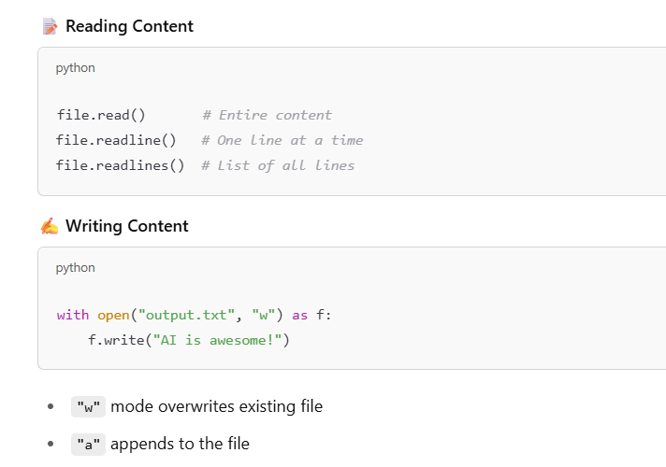
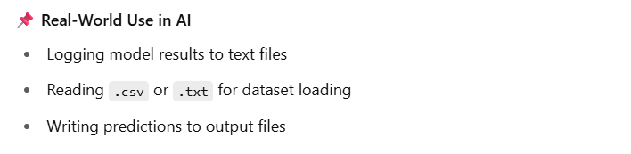
Reading and Writing to Files

Slide 4
Short Break(10 min)

Slide 5
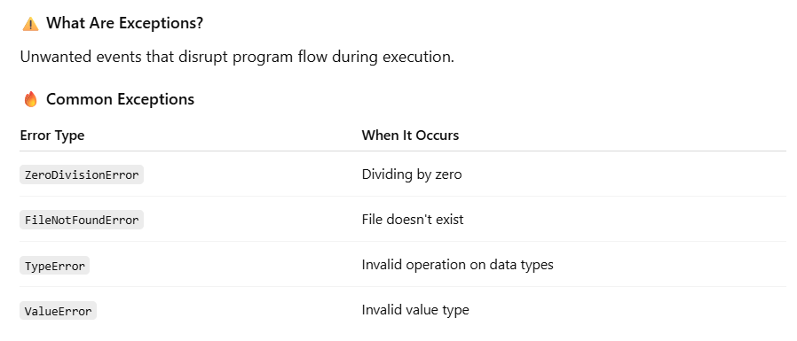
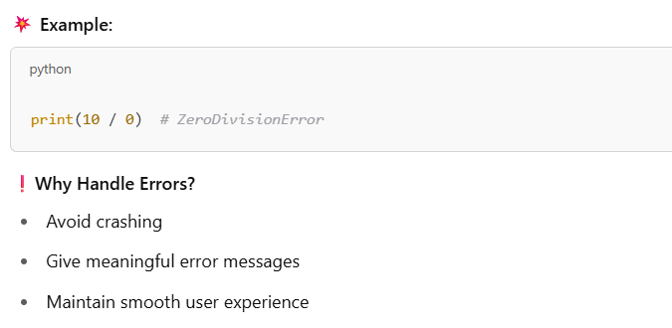
Introduction to Errors & Exceptions

Slide 6
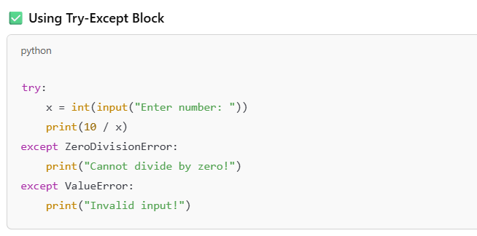
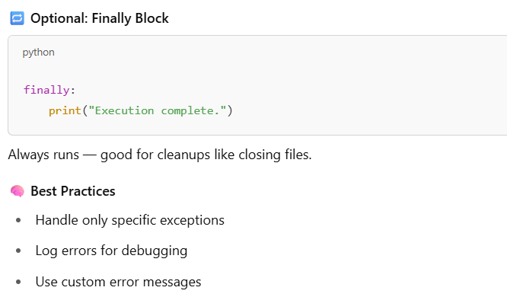
Using Try-Except for Error Handling

Slide 7
Main Break(30 min)

Slide 8
QnA
And
Feedback
Next: Numpy Basics

